Slide 1
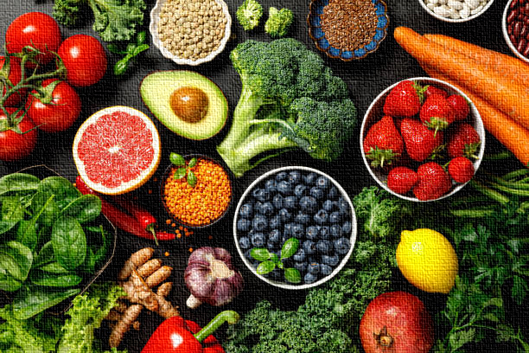
Major Project : "Diet Recommendation System"
Ankita A. Lohakare
Data Science Trainee
MetaScifor Technologies

Slide 2
Agenda
INTRODUCTION
OBJECTIVES
DATASET & TECHNOLOGY
METHODOLOGY & MODEL DETAILS
CONCLUSION

Slide 3
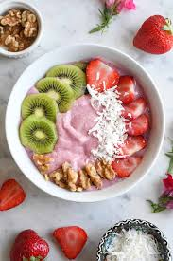
Introduction:
Problem Statement: "Many individuals struggle to create personalized diets suited to their health and goals.“
Solution: "A web application that recommends a diet plan based on personal inputs and calorie needs.“
The Diet Recommendation System is a personalized web application designed to recommend dietary options based on an individual's unique characteristics, preferences, and health goals.

Slide 4
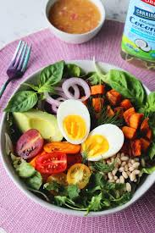
Objectives
Predict individual calorie requirements.
Provide meal recommendations (breakfast, lunch, dinner).
Incorporate dietary preferences and medical conditions.
Visualize the Calorie Distribution for better understanding.

Slide 5
Dataset Overview
Synthetic Dataset Creation: A dataset with the following features was generated synthetically for this project.
The dataset includes key features related to a user's demographics, physical attributes, lifestyle, and health preferences like – Age, Gender, Weight & Height, Activity level, Health Goal, Calories etc.
Data was preprocessed (e.g., one-hot encoding for categorical variables).

Slide 6




Technology Stack
Lists of tools and technologies used in this project.
Programming: Python
Libraries: Scikit-Learn, Pandas, NumPy, Matplotlib, Streamlit
APIs: Spoonacular API for recipe suggestions
ML Model: Random Forest Algorithm

Slide 7
Methodology
Collect the users input through Streamlit UI.
Predict calorie requirements using a Random Forest Regressor.
Recommend recipes based on Spoonacular API or predefined database.

Slide 8
Model Details
Random Forest Regressor: The Random Forest Regressor is an ensemble machine learning algorithm that combines multiple decision trees to improve predictive accuracy and control overfitting.
Why Random Forest Regressor Was Chosen:
High Accuracy: The ensemble nature of Random Forest ensures better predictions by reducing overfitting compared to a single decision tree.
Feature Importance: It provides insights into the importance of input features, which aids in understanding the model.
Handles Categorical and Numerical Data: It effectively processes mixed data types, aligning well with the input dataset.
Robustness: Performs well even with noisy or missing data, making it suitable for practical applications.

Slide 9
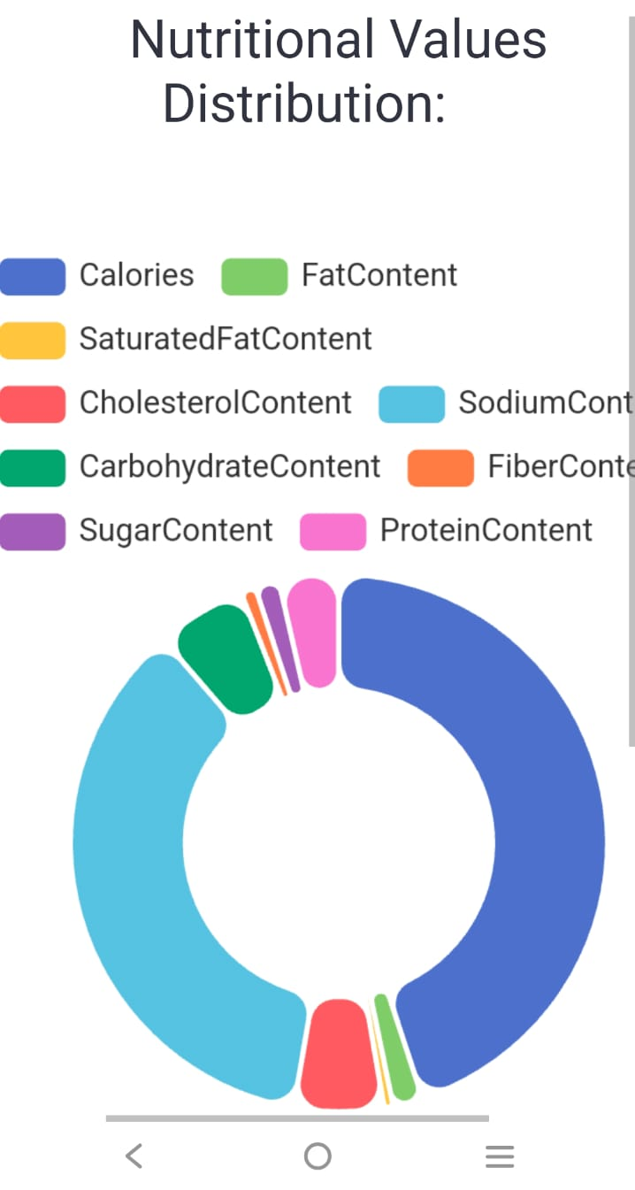
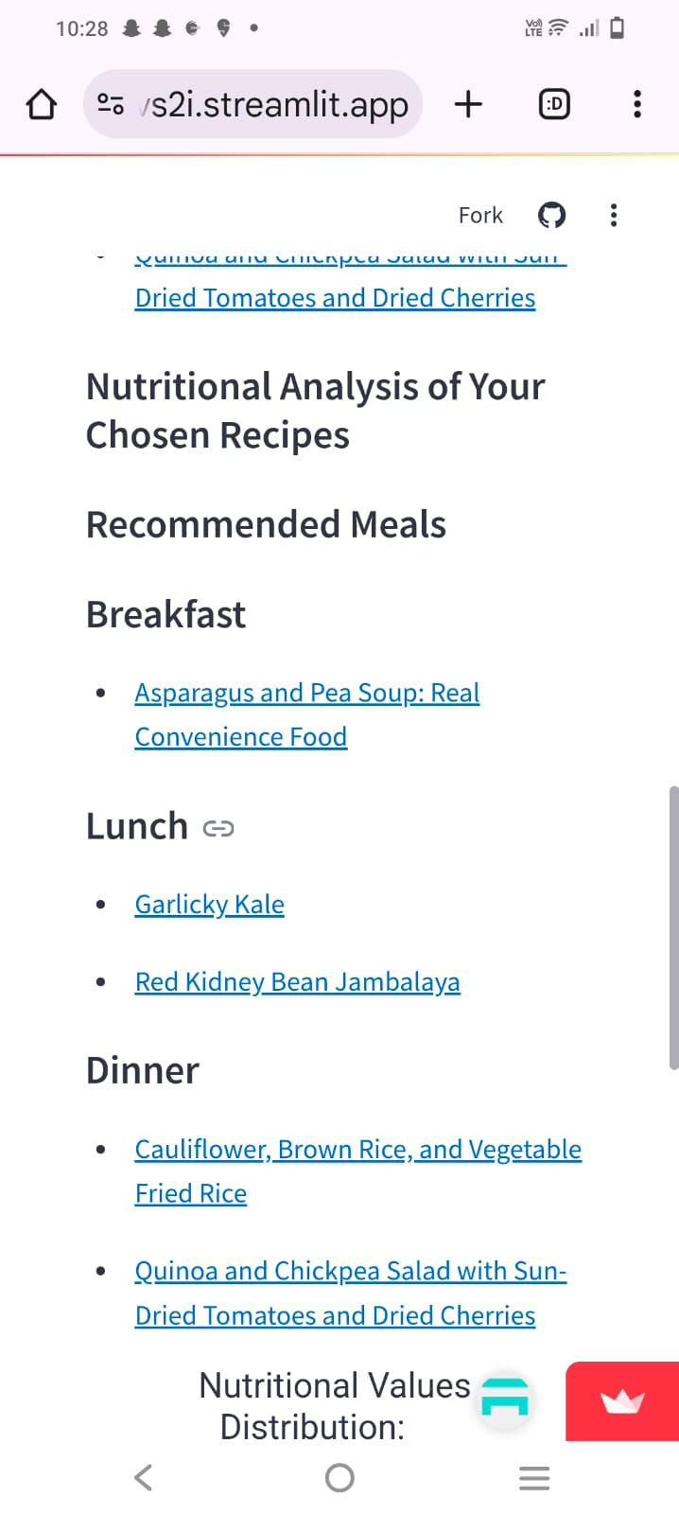
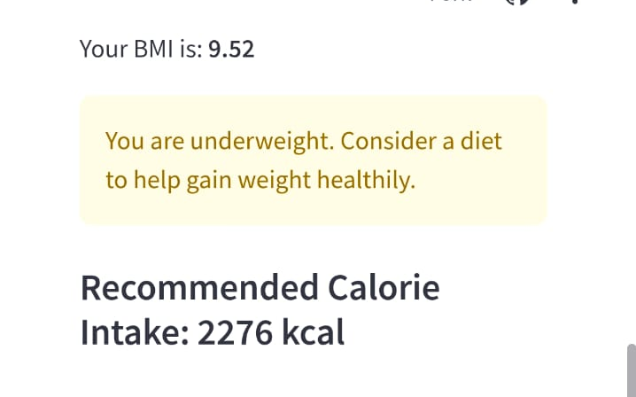
Results
A sample display of prediction and recommendation:
Predicted calorie intake.
Recipes suggested by meal.
Visualize calorie and nutritional value distribution with a pie chart.

Slide 10


Future Enhancements
We can do potential improvements like-
Real-world dataset integrations.
Advanced models like deep learning for calorie prediction.
Expanding recipe categories or adding regional cuisines.
Scalability for Mobile Apps - Develop a mobile application to make the system accessible on-the-go.

Slide 11
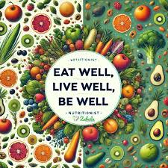
Conclusion
Purpose and Accomplishments:
The Diet Recommendation System effectively combines machine learning and a user-friendly interface to deliver personalized dietary recommendations.
It empowers individuals to achieve their health and wellness goals by providing tailored meal plans based on calorie needs, dietary preferences, and medical conditions.

Slide 12
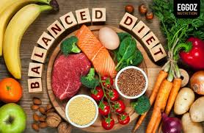
Value to Users:
"Empowering individuals to achieve their health goals with personalized diet plans."
"Let food be thy medicine and medicine be thy food." – Hippocrates

Slide 13
Thank you

